Slide 1

Unit 8: THE WEATHER
Lesson 3.1
Page 112

Slide 2
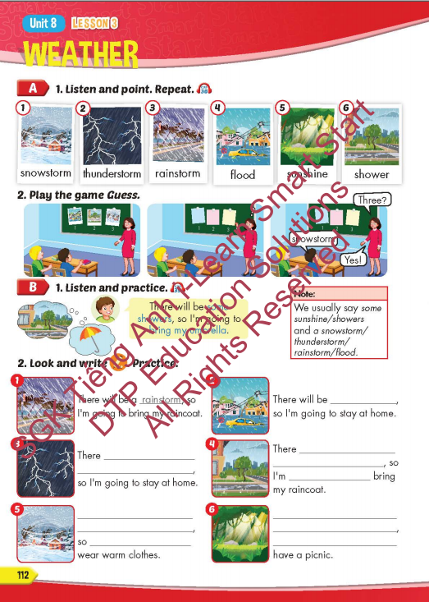
Lesson Outline
Warm-up
Vocabulary
Structure
Consolidation
Wrap-up

Slide 3
Objectives
By the end of this lesson, students will be able to to talk about future weather and the things they're going to do.
Vocabulary: snowstorm, thunderstorm, rainstorm, flood, sunshine, shower.
Structure: There will be some showers, so I'm
going to bring my umbrella.

Slide 4


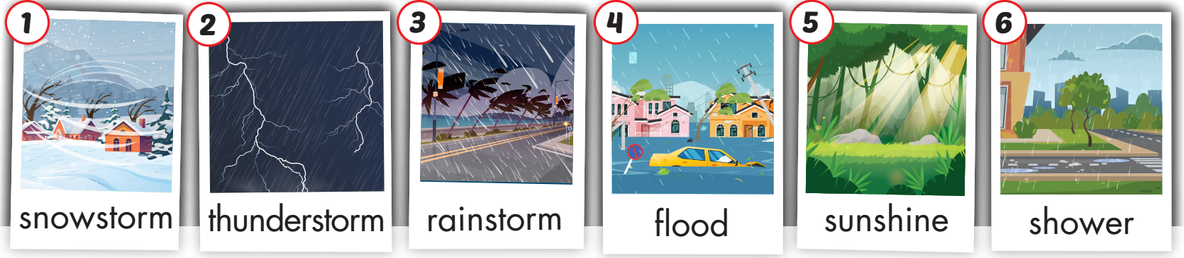
Click on A to hear the sound.
/ˈsnoʊstɔːrm/
bão tuyết
/ˈθʌndərstɔːrm/
giông bão
/ˈreɪnstɔːrm/ mưa bão
/flʌd/
ngập lụt, lũ lụt
/ˈsʌnʃaɪn/
ánh nắng mặt trời
/ˈʃaʊər/ cơn mưa rào

Slide 5

Click on the picture to hear the sound.
Snowstorm (n)
/ˈsnoʊstɔːrm/
bão tuyết

Slide 6
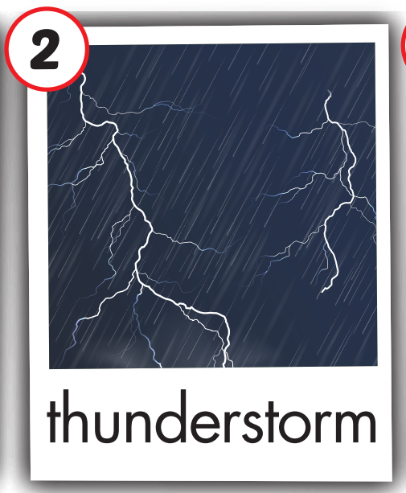
Click on the picture to hear the sound.
thunderstorm (n)
/ˈθʌndərstɔːrm/
giông bão

Slide 7
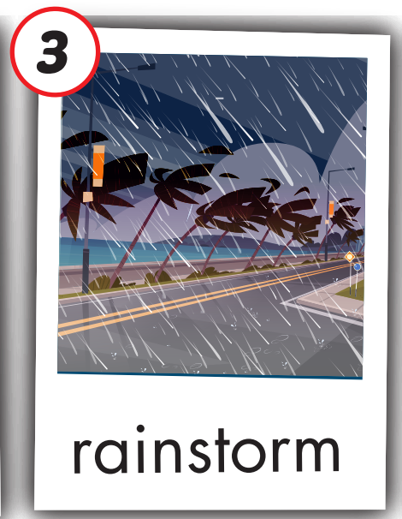
Click on the picture to hear the sound.
rainstorm (n)
/ˈreɪnstɔːrm/ mưa bão

Slide 8
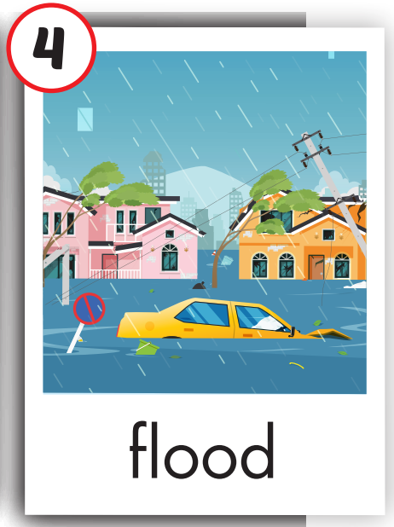
Click on the picture to hear the sound.
flood (n)
/flʌd/
ngập lụt, lũ lụt

Slide 9
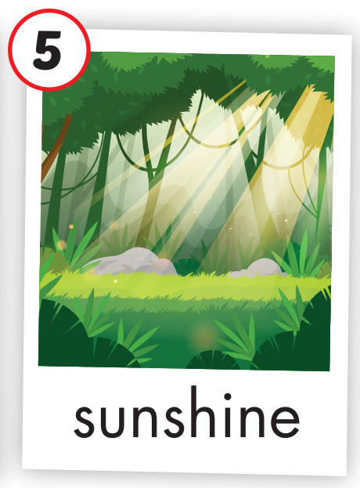
Click on the picture to hear the sound.
sunshine (n)
/ˈsʌnʃaɪn/
ánh nắng mặt trời

Slide 10
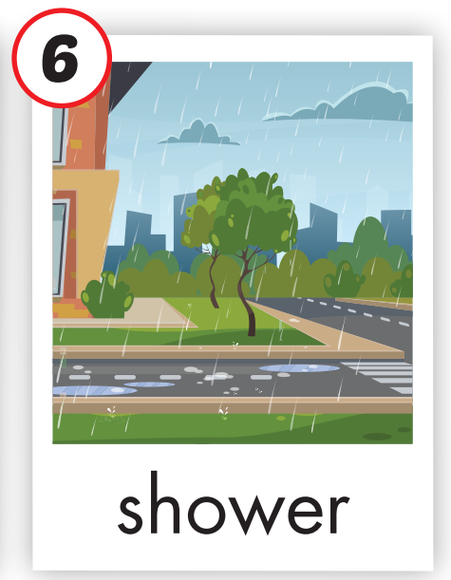
Click on the picture to hear the sound.
shower (n)
/ˈʃaʊər/ cơn mưa rào

Slide 11

Practice

Slide 12
Look, read and choose

Slide 13

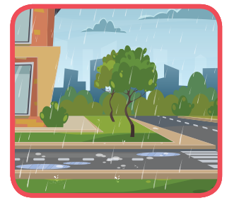
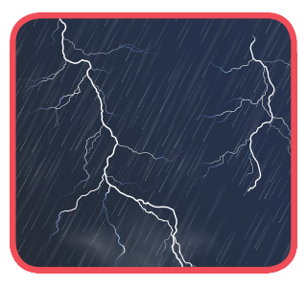
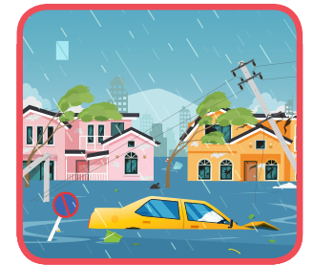
Read and choose
shower
A
B
C

Slide 14
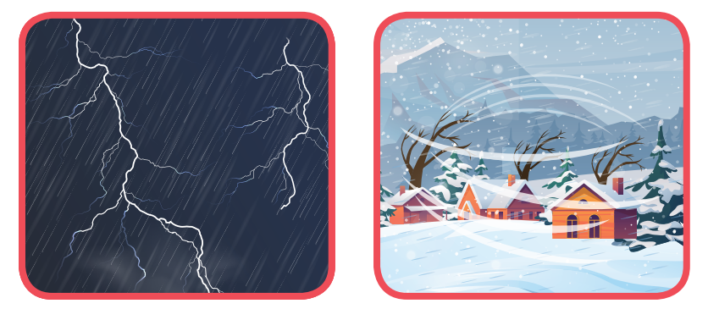
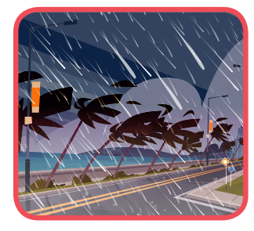
Listen and choose
rainstorm
A
B
C

Slide 15


Read and choose
sunshine
A
B
C

Slide 16
Read and choose
flood
A
B
C

Slide 17
Read and choose
thunderstorm
A
B
C

Slide 18

Enjoy your day!

Slide 19

Lesson 3
Stay positive and have a nice day!

